Slide 1
Batching in the Modern Enterprise
September 2-3, 2020 springone.io
#session-batching-for-the-modern-enterprise

Slide 2

THANK YOU
Notes:
We live in crazy times and I want to thank you for taking time out of your lives to spend it with us here at Spring One.

Slide 3

MICHAEL MINELLA
Lead – Spring Batch &
Spring Cloud Task
JBatch – Committer
Author – The Definitive Guide
to Spring Batch
Speaker - JavaOne Rockstar
Java Champion
Podcast - OffHeap Curmudgeon

Slide 4
@michaelminella
@springbatch
@offheap

Slide 5
AVAILABLE
NOW!
https://www.apress.com/us/book/9781484237236

Slide 6


Slide 7
LIES

Slide 8


Slide 9

BATCH IS DEAD!

Slide 10


Notes:
Cloud Native Computing Foundation Serverless Whitepaper

Slide 11
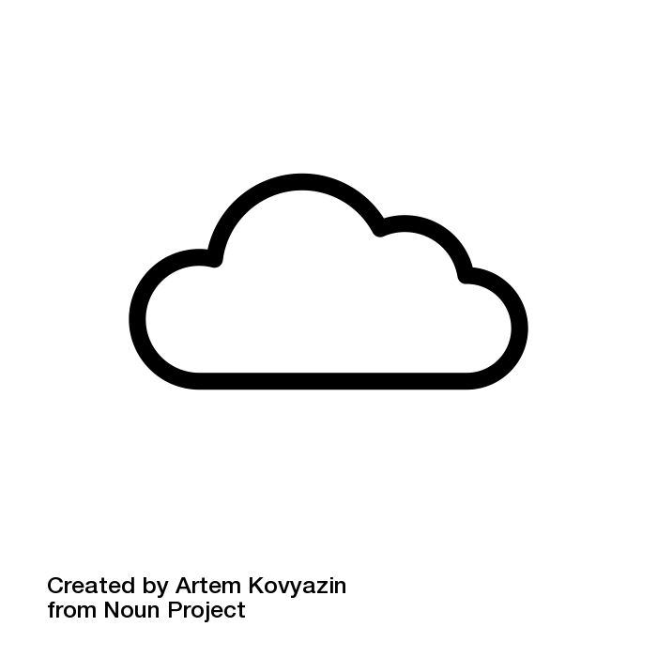

BATCH PROCESSING
FOLLOWS
AS WORKLOADS
MOVE TO THE CLOUD

Slide 12
¯\_(ツ)_/¯

Slide 13

WHAT IS BATCH
PROCESSING?

Slide 14

SPRING BATCH

Slide 15
WHAT IS BATCH
PROCESSING?

Slide 16
Batch processing, … is defined as the processing of a finite amount of data without interaction or interruption
-- Michael Minella
The Definitive Guide to Spring Batch

Slide 17

FINITE AMOUNT
OF DATA

Slide 18

WITHOUT INTERACTION
OR INTERUPTION

Slide 19


Slide 20
BATCH IS MOVING
TO THE CLOUD

Slide 21
SPRING BATCH

Slide 22

THE DEFACTO STANDARD FOR
BATCH PROCESSING ON THE JVM

Slide 23


+
Notes:
Went 1.0 March 2008.

Slide 24



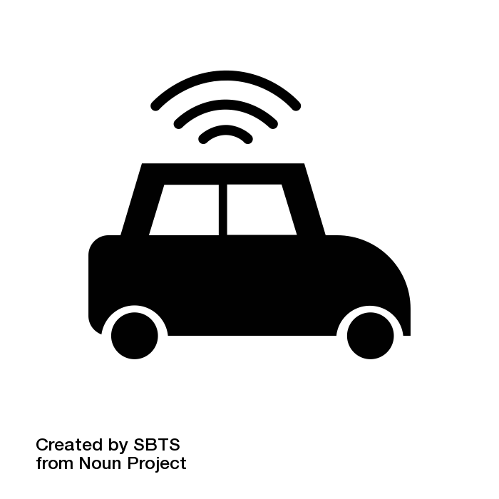

USED IN EVERY VERTICAL

Slide 25
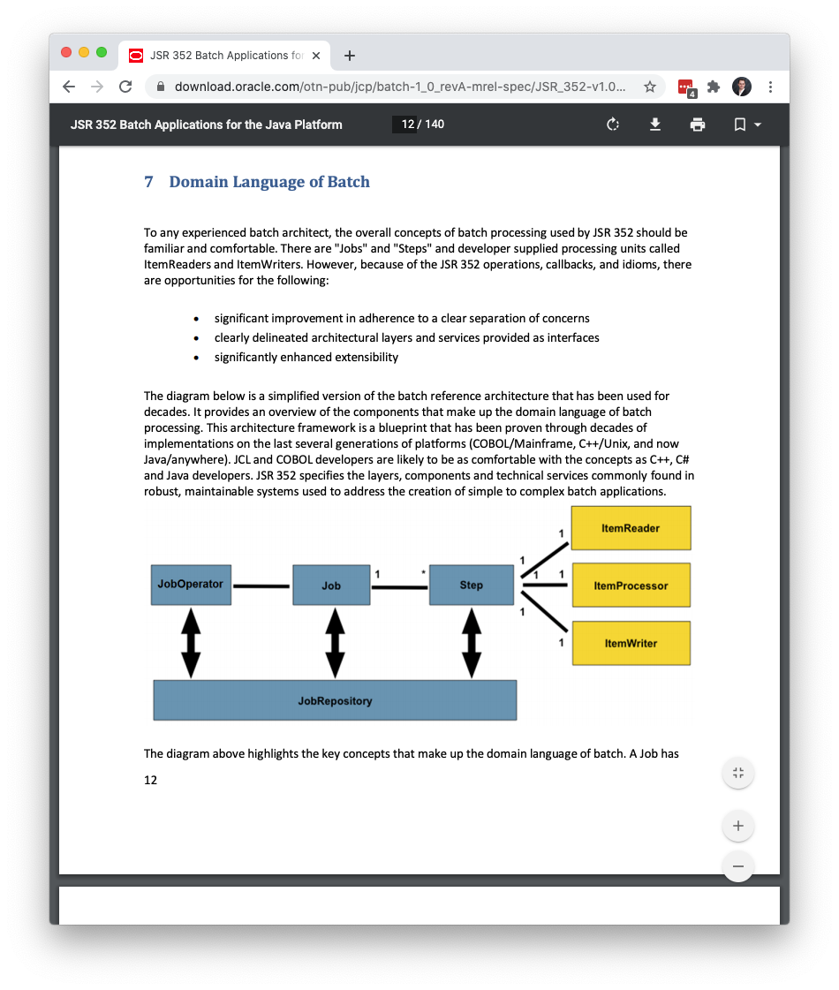
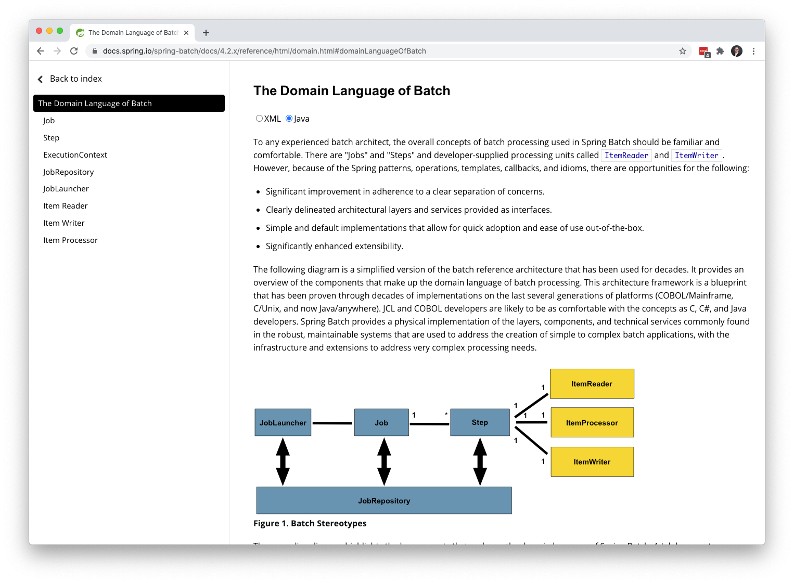
SERVED AS THE INSPIRATION
OF JSR-352

Slide 26

LINGO

Slide 27

JOB

Slide 28
STEP

Slide 29


TASKLET VS CHUNK

Slide 30

ITEM

Slide 31
CHUNK

Slide 32
FLOW OF STEPS/COMPONENTS
STEP1
STEP2
STEP3
ItemReader
ItemReader
ItemReader
ItemProcessor
ItemProcessor
ItemProcessor
ItemWriter
ItemWriter
ItemWriter

Slide 33


Slide 34
INFRASTRUCTURE
ItemReader
JobLauncher
Job
Step
ItemProcessor
ItemWriter
JobRepository

Slide 35
JobInstance
date=09/02/2020
1
*
JobExecution
1
*
StepExecution

Slide 36
/** * @author Michael Minella */ @EnableBatchProcessing @Configuration public class BatchConfiguration { @Autowired private JobBuilderFactory jobBuilderFactory; @Autowired private StepBuilderFactory stepBuilderFactory; @Bean @StepScope public FixedWidthCobolItemReader<Store> reader(@Value("file:#{jobParameters['localFilePath']}") Resource inputFile, @Value("${job.copybook}") Resource copybook) throws Exception { FixedWidthCobolItemReader<Store> itemReader = new FixedWidthCobolItemReader<>(inputFile, copybook, line -> { Store store = new Store(); store.setStoreNumber(line.getFieldValue("STORE-NO").asInt()); store.setRegionNumber(line.getFieldValue("REGION-NO").asInt()); store.setStoreName(line.getFieldValue("STORE-NAME").asString()); store.setNewStore(line.getFieldValue("NEW-STORE").asString().equals("Y")); store.setActiveStore(line.getFieldValue("ACTIVE-STORE").asString().equals("Y")); store.setClosedStore(line.getFieldValue("CLOSED-STORE").asString().equals("Y")); store.setDcType(line.getFieldValue("DC-TYPE").asString());

Slide 37
public interface ItemReader<T> {
@Nullable
T read() throws Exception,
UnexpectedInputException,
ParseException,
NonTransientResourceException;
}

Slide 38
19 OUT OF THE BOX ITEMREADER
IMPLEMENTATIONS
AbstractItemCountingItemStreamItemReader
AggregateItemReader
AmqpItemReader
FlatFileItemReader
KafkaItemReader
HibernateCursorItemReader
HibernatePagingItemReader
ItemReaderAdapter
JdbcCursorItemReader
JdbcPagingItemReader
JmsItemReader
JpaPagingItemReader
ListItemReader
MongoItemReader
Neo4jItemReader
RepositoryItemReader
StoredProcedureItemReader
StaxEventItemReader
JsonItemReader

Slide 39
public interface ItemProcessor<I, O> {
@Nullable
O process(@NonNull I item) throws
Exception;
}

Slide 40
10 OUT OF THE BOX ITEMPROCESSOR
IMPLEMENTATIONS
AsycnItemProcessor
BeanValidatingItemProcessor
ClassifierCompositeItemProcessor
CompositeItemProcessor
FunctionItemProcessor
ItemProcessorAdapter
PassThroughItemProcessor
ScriptItemProcessor
ValidatingItemProcessor

Slide 41
public interface ItemWriter<T> {
void write(List<? extends T> items) throws
Exception;
}

Slide 42
18 OUT OF THE BOX ITEMWRITER
IMPLEMENTATIONS
AbstractItemStreamItemWriter
AmqpItemWriter
CompositeItemWriter
FlatFileItemWriter
GemfireItemWriter
HibernateItemWriter
ItemWriterAdapter
JdbcBatchItemWriter
JmsItemWriter
JpaItemWriter
KafkaItemWriter
MimeMessageItemWriter
MongoItemWriter
Neo4jItemWriter
PropertyExtractingDelegatingItemWriter
RepositoryItemWriter
StaxEventItemWriter
JsonFileItemWriter

Slide 43
public interface ItemStream {
void open(ExecutionContext ec)
throws ItemStreamException;
void update(ExecutionContext ec)
throws ItemStreamException;
void close() throws ItemStreamException;
}

Slide 44
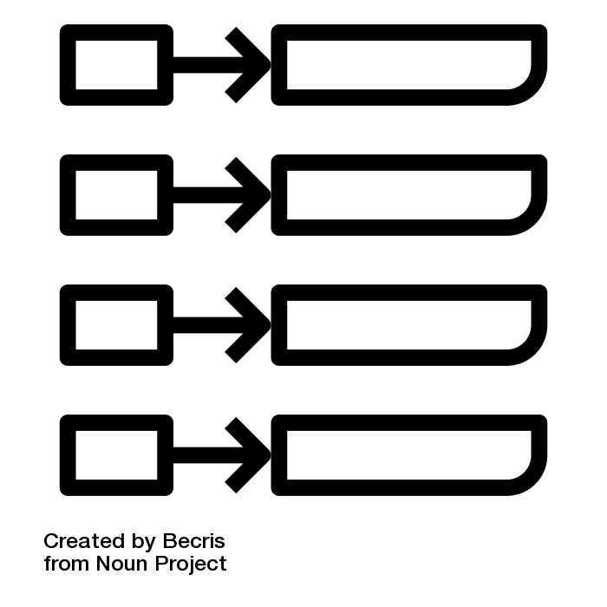
ExecutionContext

Slide 45
/** * @author Michael Minella */ @EnableBatchProcessing @Configuration public class BatchConfiguration { @Autowired private JobBuilderFactory jobBuilderFactory; @Autowired private StepBuilderFactory stepBuilderFactory; @Bean @StepScope public FixedWidthCobolItemReader<Store> reader(@Value("file:#{jobParameters['localFilePath']}") Resource inputFile, @Value("${job.copybook}") Resource copybook) throws Exception { FixedWidthCobolItemReader<Store> itemReader = new FixedWidthCobolItemReader<>(inputFile, copybook, line -> { Store store = new Store(); store.setStoreNumber(line.getFieldValue("STORE-NO").asInt()); store.setRegionNumber(line.getFieldValue("REGION-NO").asInt()); store.setStoreName(line.getFieldValue("STORE-NAME").asString()); store.setNewStore(line.getFieldValue("NEW-STORE").asString().equals("Y")); store.setActiveStore(line.getFieldValue("ACTIVE-STORE").asString().equals("Y")); store.setClosedStore(line.getFieldValue("CLOSED-STORE").asString().equals("Y")); store.setDcType(line.getFieldValue("DC-TYPE").asString());

Slide 46

ERROR HANDLING

Slide 47

RESTART

Slide 48

SKIP

Slide 49

RETRY

Slide 50
/** * @author Michael Minella */ @EnableBatchProcessing @Configuration public class BatchConfiguration { @Autowired private JobBuilderFactory jobBuilderFactory; @Autowired private StepBuilderFactory stepBuilderFactory; @Bean @StepScope public FixedWidthCobolItemReader<Store> reader(@Value("file:#{jobParameters['localFilePath']}") Resource inputFile, @Value("${job.copybook}") Resource copybook) throws Exception { FixedWidthCobolItemReader<Store> itemReader = new FixedWidthCobolItemReader<>(inputFile, copybook, line -> { Store store = new Store(); store.setStoreNumber(line.getFieldValue("STORE-NO").asInt()); store.setRegionNumber(line.getFieldValue("REGION-NO").asInt()); store.setStoreName(line.getFieldValue("STORE-NAME").asString()); store.setNewStore(line.getFieldValue("NEW-STORE").asString().equals("Y")); store.setActiveStore(line.getFieldValue("ACTIVE-STORE").asString().equals("Y")); store.setClosedStore(line.getFieldValue("CLOSED-STORE").asString().equals("Y")); store.setDcType(line.getFieldValue("DC-TYPE").asString());

Slide 51

LISTENERS

Slide 52

SCALING BATCH
PROCESSES

Slide 53
1
MULTITHREADED STEPS

Slide 54
2
PARALLEL STEPS

Slide 55
3
ASYNC
ITEMPROCESSOR/ITEMWRITER

Slide 56
4
PARTITIONING

Slide 57
5
REMOTE CHUNKING

Slide 58
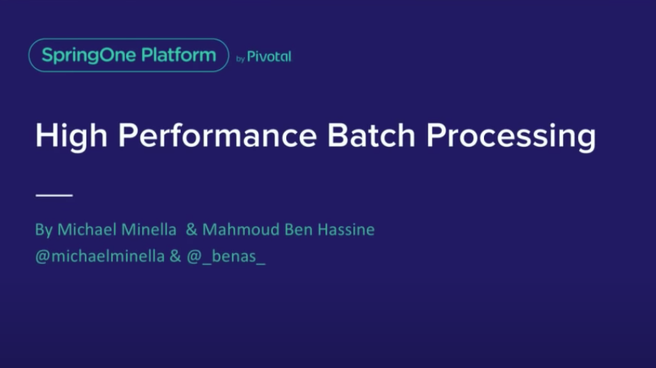
https://www.youtube.com/watch?v=J6IPlfm7N6w

Slide 59

ORCHESTRATION

Slide 60

SPRING CLOUD TASK

Slide 61

SPRING CLOUD DATA FLOW

Slide 62
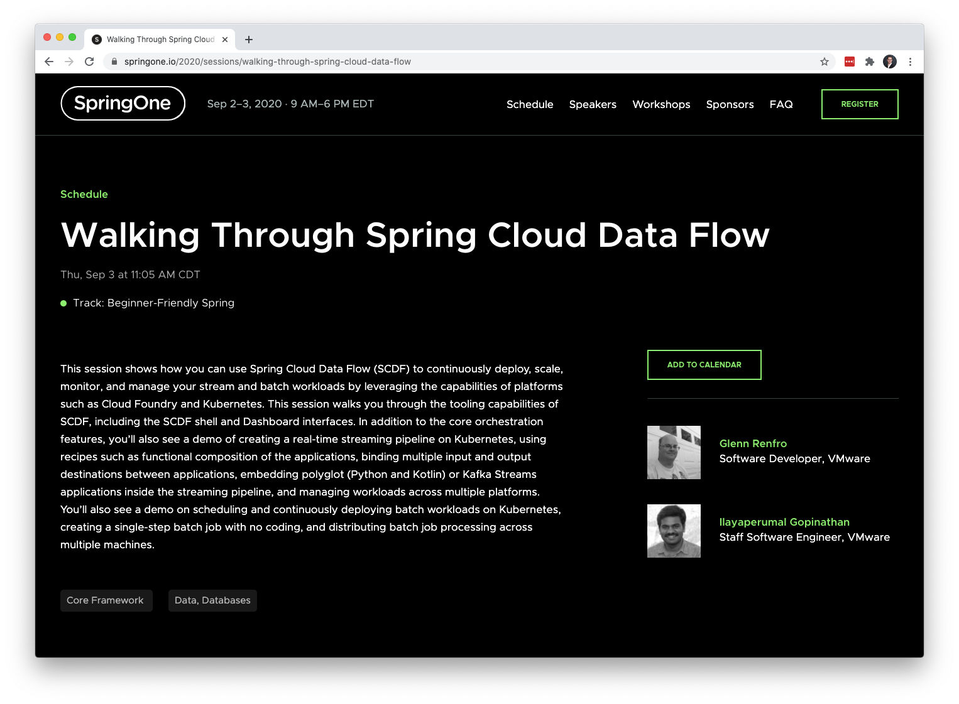

Slide 63
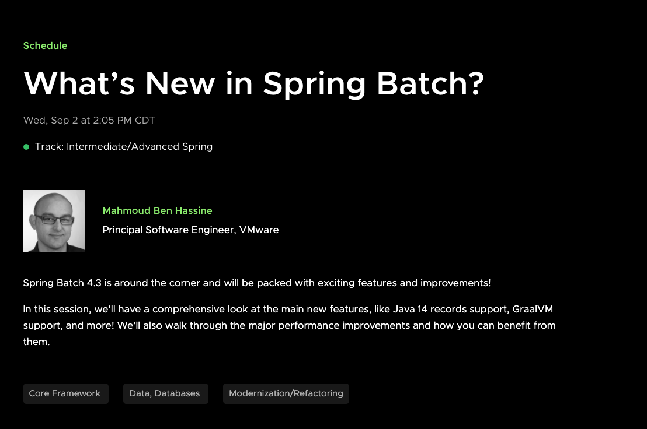

Slide 64
THANK YOU

Slide 65




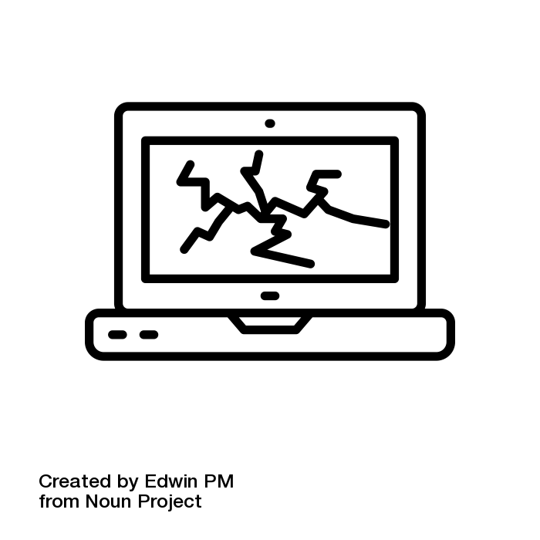


Slide 66



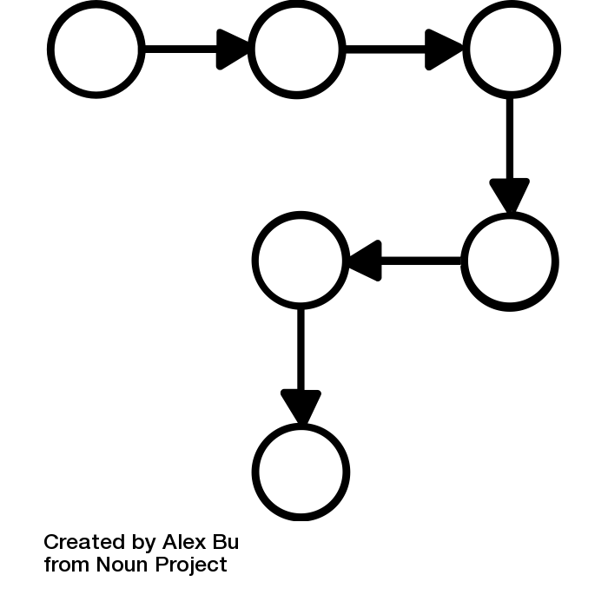


Slide 67


Stay Connected.
Follow us at @springbatch
What’s New in Spring Batch – Sept 2 3:05 PM EDT
Spring Cloud Data Flow AMA – Sept 2 4:05 PM EDT
Walking through Spring Cloud Data Flow – Sept 3 12:05 PM EDT
@s1p
#springone

